Slide 1
UVa 10976 Fractions Again

Slide 2
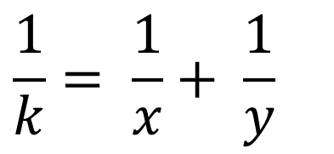
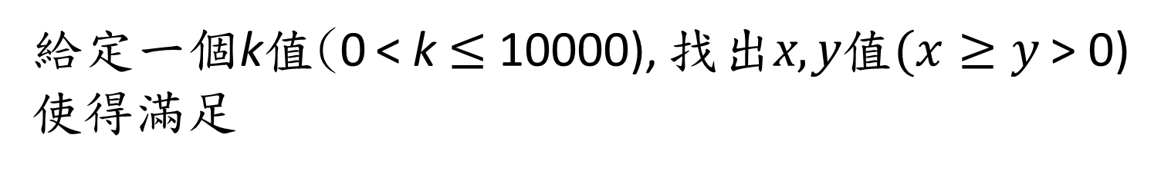
UVa 10976 Fractions Again (Time Limit: 3 seconds)
給定一個k值(0 < k $≤$ 10000), 找出x, y值$(x≥y$ > 0) 使得滿足
$$\frac{1}{k}= \frac{1}{x}+ \frac{1}{y}$$

Slide 3
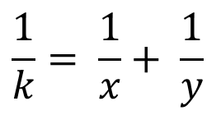
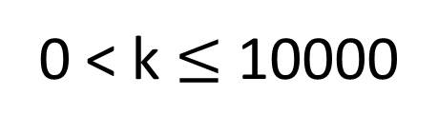
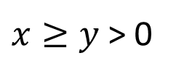
Sample Input
Sample Output
# of (x,y) pair solutions
k
2
1/2 = 1/6 + 1/3
1/2 = 1/4 + 1/4
8
1/12 = 1/156 + 1/13
1/12 = 1/84 + 1/14
1/12 = 1/60 + 1/15
1/12 = 1/48 + 1/16
1/12 = 1/36 + 1/18
1/12 = 1/30 + 1/20
1/12 = 1/28 + 1/21
1/12 = 1/24 + 1/24
2
12
$$\frac{1}{k}= \frac{1}{x}+ \frac{1}{y}$$
0 < k $≤$ 10000
$x≥y$ > 0

Slide 4
Solution
Enumeration (列舉)
優雅一點的暴力法
數學分析

Slide 5

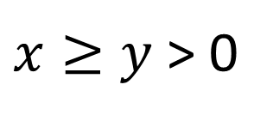
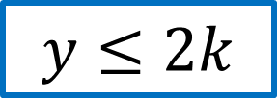
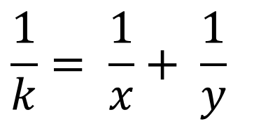
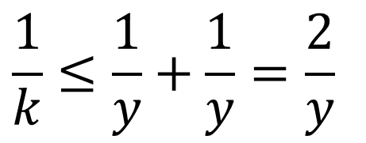
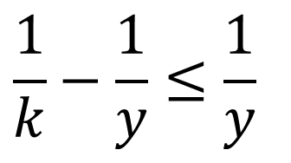
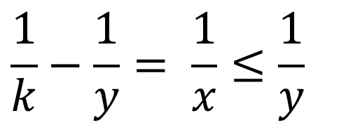
$$Given k,$$
$x≥y$ > 0
$$\frac{1}{k}= \frac{1}{x}+ \frac{1}{y}$$
$$\frac{1}{k}−\frac{1}{y}= \frac{1}{x}≤\frac{1}{y}$$
$$\frac{1}{k}−\frac{1}{y}≤\frac{1}{y}$$
$$\frac{1}{k}≤\frac{1}{y}+\frac{1}{y}=\frac{2}{y}$$
$$y≤2k$$

Slide 6
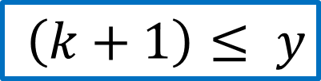

$$Given k,$$
$x≥y$ > 0
$$\frac{1}{k}= \frac{1}{x}+ \frac{1}{y}$$
$$y 明顯的大於等於k+1$$
$$\left(k+1\right)≤ y$$

Slide 7
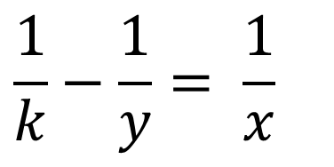
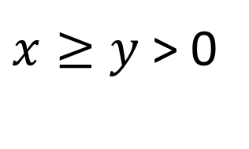

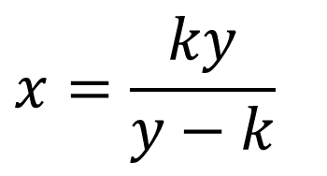
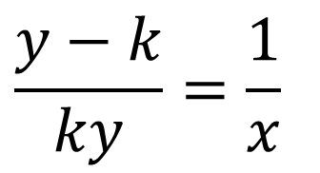
$$Given k,$$
$x≥y$ > 0
$$\frac{1}{k}= \frac{1}{x}+ \frac{1}{y}$$
$$\frac{1}{k}−\frac{1}{y}= \frac{1}{x}$$
$$\frac{y−k}{ky}=\frac{1}{x}$$
$$x=\frac{ky}{y−k}$$
$$ky可以被(y−k)整除,x就有解$$

Slide 8
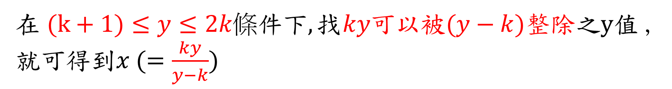

總結
已知$k 值$
在$(k+1)≤y≤2k條件下,找ky可以被(y−k)整除之y值$,就可得到$x (=\frac{ky}{y−k})$

Slide 9
#include<cstdio>
#include<vector>
using namespace std;
int main() {
int k;
while(scanf(“%d”, &k) == 1 && k) { // 輸入k值
vector<int> X, Y; // 暫存 (x,y)解
for(int y = k+1; y <= k*2; y++) { // 檢驗(k+1)<=y<=2*k每一個y值,看看是否有解
// 1/k = 1/x + 1/y => x = ky/(y-k)
if(k*y%(y-k) == 0) //k*y可以被(y-k)整除?
{ X.push_back(k*y/(y-k)); Y.push_back(y); } // 找到x, y並存x, y值
}
printf(“%d\n”, X.size()); // 印出結果
for(int i = 0; i < X.size(); i++)
printf("1/%d = 1/%d + 1/%d\n", k, X[i], Y[i]);
}
return 0;
}
UVa 10976 Code

